Slide 1
LWC Fundamentals

Slide 2
AGENDA
Introduction to LWC
LWC Structure
Creation of Hello World component
Applying CSS
Data Binding
Decorators
Looping and Iteration
Conditional Rendering
Component Library Overview

Slide 3
Introduction to LWC
LWC uses Core Web Components and is built on code native to web browsers (HTML , JS, CSS)
Most of code we write is standard HTML and JS
Its performance is better than Aura Components because of absence of abstraction layer
LWC can be added into Aura but Aura cannot be added into LWC

Slide 4
Introduction to LWC
Advantages of LWC Over Aura and VF:
Easy To Learn
Absence of abstraction layer as compared to Aura
It uses web standards and Native HTML, CSS, JS
Performance is faster
No view state limit

Slide 5
LWC Structure
Additional Files
CSS Design File – This file is used to hold the styling developed for the component
Helper / Utility JS – A helper/utility file stores reusable JavaScript methods.
SVG File – An SVG file gives users the option to include icons that could be used for future reference.

Slide 6
LWC Structure
Required Files
HTML File : A mark-up language used to structure the component layout. (Front End Logic)
JS File: JavaScript controller to handle processing (Backend logic)
Metadata XML File: This file is used to control the Component's visibility and the locations where we can add this component

Slide 7
Hello World Component
Command Pallet (Ctrl + Shift + p) >> Create Lightning Web Component
2. Add logic in HTML , JS
3. Configure Meta XML file by adding targets and exposed property.

Slide 8
Applying CSS
Ways To Apply CSS in LWC
1. Create CSS file and add styling. File name should be same
2. Inline Styling
<div style="color:green;font-size:10px;"></div>
3. By Using Lightning Design System. (SLDS)
<div class=”slds-align_absolute-center"></div>

Slide 9
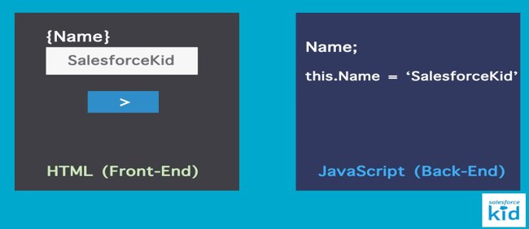
Data Binding
Mapping the data from the backend(JS) to the front end(HTML)

Slide 10
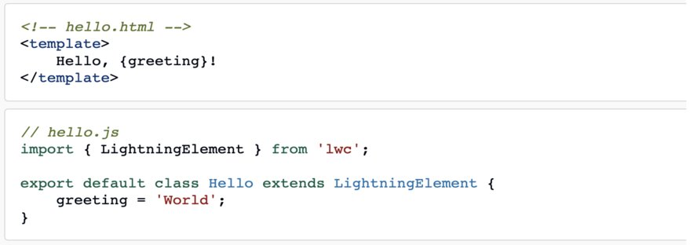
Data Binding
1. By Using Expressions

Slide 11
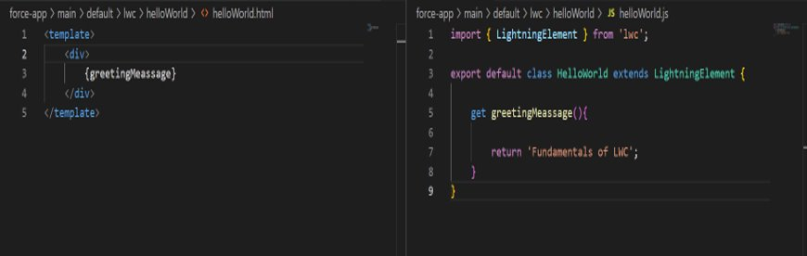
Data Binding
2. By Using getters

Slide 12
Decorators In LWC
@wire​
@Api​
@track​

Slide 13
Decorators
@api:
This decorator is used to make any property, method as Public
Public properties are reactive
@api is also use to get the record Id provided by salesforce

Slide 14
Decorators
2. @wire:
This decorator is used to invoke apex class method everytime the component is loaded
Execution of wire method cannot be controlled
@AuraEnabled(Cachable=true) is compulsory
DMLs are not allowed
Wire methods are executed only when the component is loaded.
To re execute wire method whenever the input parameter is changed we can use ‘$inputParamter’
Example: @wire(getContactsRelatedToAccount, {accountId: ‘$recordId’})

Slide 15
Decorators
3. @track:
This decorator is used to tell the framework to observe changes of variables, arrays, objects
This decorator is used to track changes
After Spring’20 all variables are by default track and private.
In case of nested array, it does not get tracked by default, so to make nested array trackable, we can add @track

Slide 16
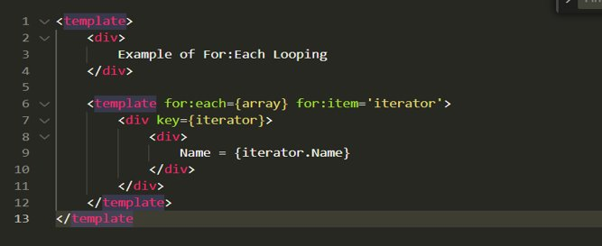
Looping And Iteration
1. For:Each Loop :

Slide 17
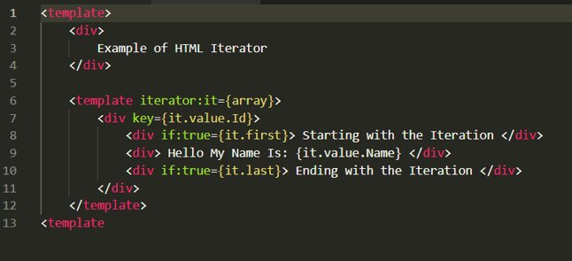
Looping And Iteration
2. Iterator :

Slide 18
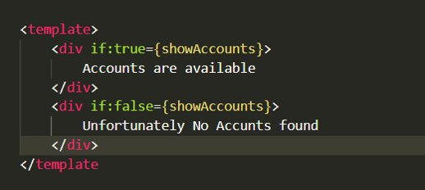
Conditional Rendering
Conditional Rendering can be achieved by using
1. If:true={showAccounts}
2. If:false={showAccounts}

Slide 19
Component Library Overview
Salesforce has taken care of all our needs and has already provided us enough documentation and tools to get started on LWC and Aura.
The best place to find documentation of LWC and base components.
Link: https://developer.salesforce.com/docs/component-library/overview/components

Slide 20
Component Library Overview
For Example
Lightning Progress Bar:
<template>
<lightning-progress-bar value="90" size="large"></lightning-progress-bar>
</template>

Slide 21
Thanks
Any Questions ?

